Slide 1

Salary Predictions of Data Professions

Slide 2
Why is salary prediction important?
In the current generation, salary prediction is crucial for both employers and employees as a lot of regular employees rely mostly on it for motivation. It helps employers and employees to make estimations of the expected salary.

Slide 3



OVERVIEW
Salaries in the field of data professions vary widely based on factors such as experience, job role, and performance. Accurately predicting salaries for data professionals is essential for both job seekers and employers.
PROBLEM STATEMENT
My task is to build a predictive machine-learning model that can be used for predicting the salaries of data professionals.

Slide 4
Dataset
`FIRST NAME`: First name | `SALARY`: Target variable, the salary of the data professional
`LAST NAME`: Last name | `UNIT`: Business unit or department
`SEX`: Gender | `LEAVES USED`: Number of leaves used
`DOJ`: Date of joining the company | `LEAVES REMAINING`: Number of leaves remaining
`CURRENT DATE`: Current date of data | `RATINGS`: Ratings or performance ratings
`DESIGNATION`: Job role/designation | `PAST EXP`: Past work experience
`AGE`: Age

Slide 5
Workflow
Data
Data Cleaning
Data Analysis
Data Preprocessing
Model Evaluation
Hyperparameter Tuning
Model Building

Slide 6
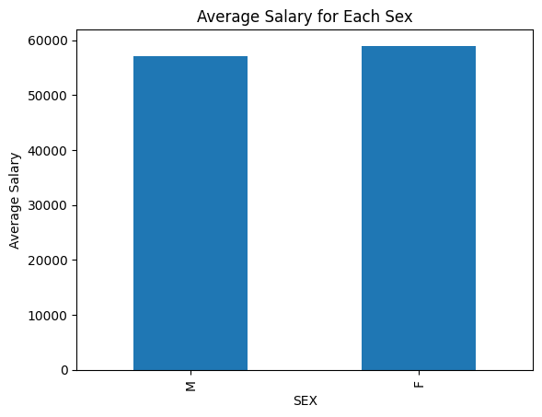
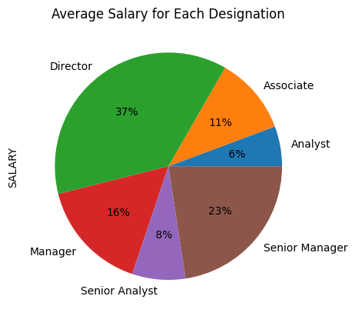
Exploratory Data Analysis

Slide 7
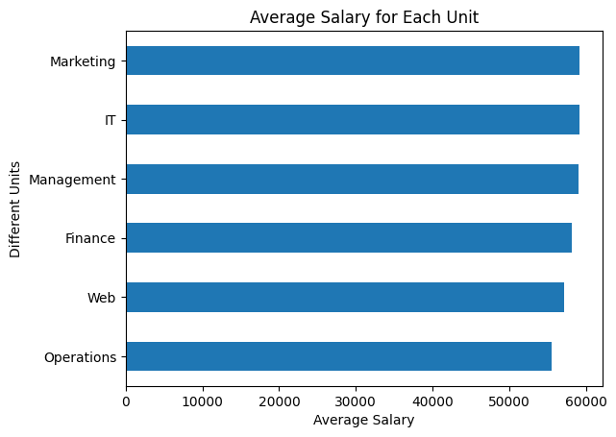
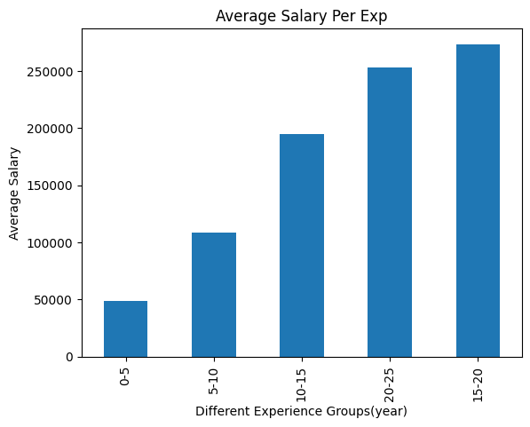
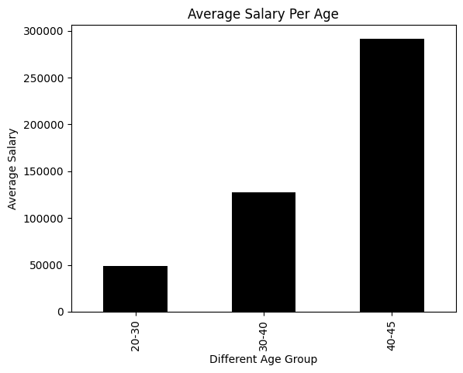

Slide 8


Machine Learning Models
Linear Regression
Random Forest Regression
Decision Tree Regression
Gradient Boosting

Slide 9
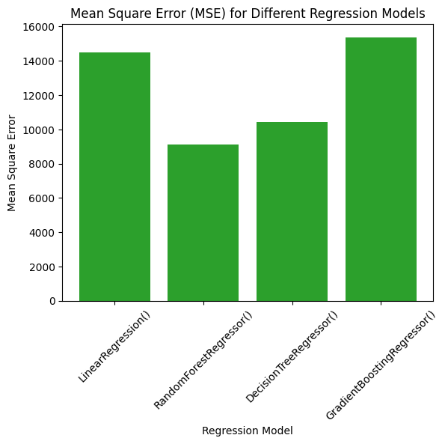
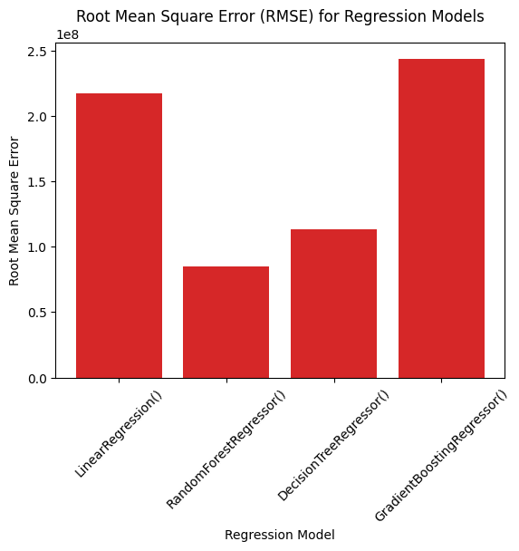
Evaluation

Slide 10
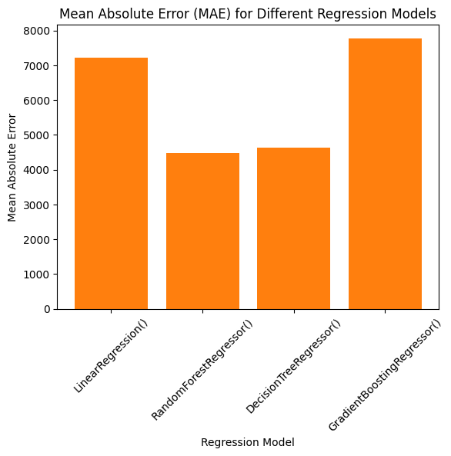
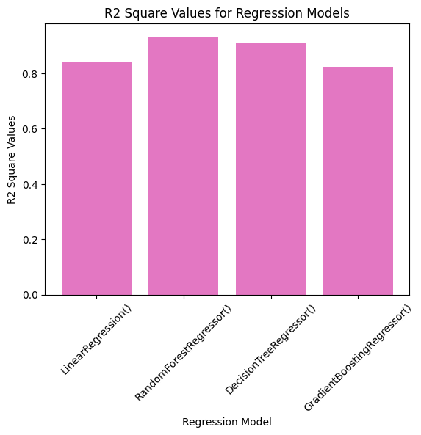
Evaluation

Slide 11
Conclusion
The person receiving the highest salary has the following attributes:
Age: 41
Designation: Director
Ratings: 4
Past exp: 18 years
Years worked in the company: 6.4
The person receiving the lowest salary has the following attributes:
Age: 21
Designation: Analyst
Ratings: 3
Past exp: 0 years
Years worked in the company: 2.8

Slide 12

Thus, an employee who is the Director in the company who has many years of experience receives the highest salary.

Slide 13

Thank you

